Slide 1

Department of Mathematics and Statistics, IIT Kanpur
Credit Card Risk Data: Group 1
Members:
Anoop Patel (231080017)
Gunavant Thakare(231080040)
Jiyanshu Dhaka(220481)
Sunny(231080094)
In the guidance of
Dr. Dootika Vats

Slide 2
Introduction
Analyze UDAAP violations in credit card services using CFPB complaint data to uncover unfair practices
Compare resolution performance across major banks and identify recurring complaint themes
Assess economic influences on complaint trends to provide actionable insights for consumer protection

Slide 3
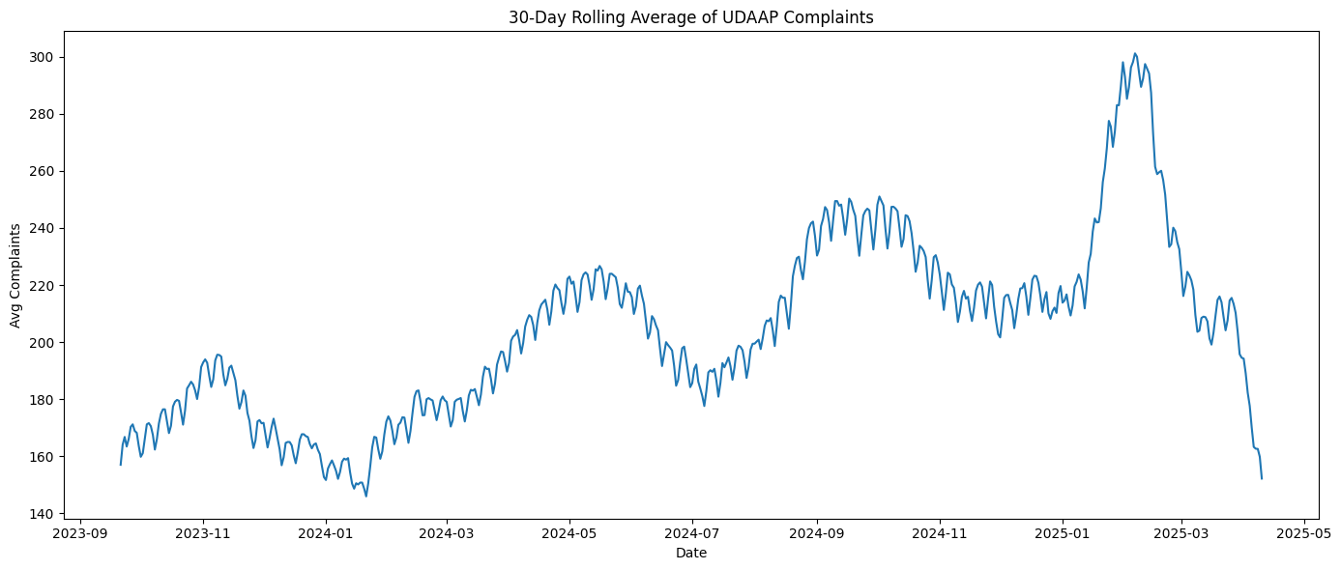
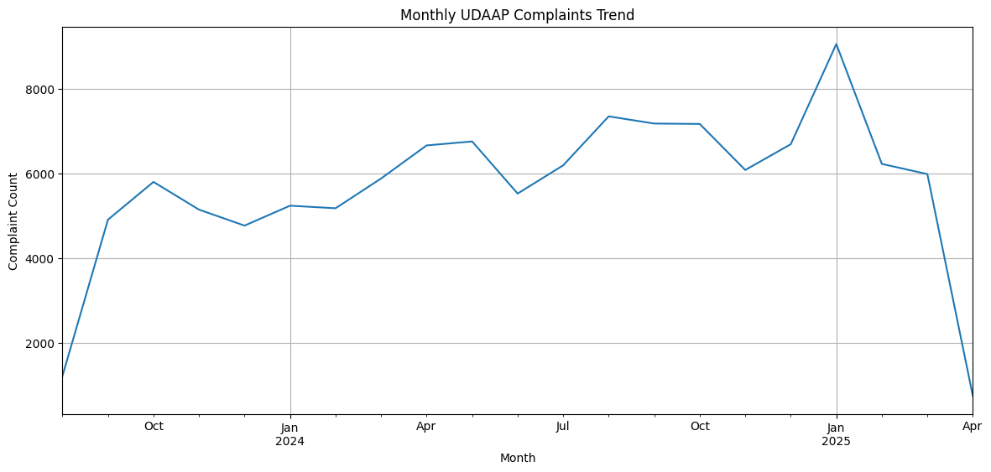
Task 1
Analyze the trends in UDAAP (Unfair, Deceptive, or Abusive Acts or Practices) complaints over time. Are the number of UDAAP complaints increasing significantly over the last two years?
Trend Analysis:
Fig1: 30-Daily Rolling Average
Fig2: Monthly UDAAP Complaints Trend

Slide 4
Visual Insights
In Figure 1, the trend indicates periodic rises and falls throughout the year, with distinct peaks around October 2023, May 2024, and a significant spike in January-February 2025. A steep drop is observed in March 2025, which might indicate seasonal effect, or incomplete data.
In Figure 2, There is a steady increase in complaints from mid-2023 through 2024, with peaks in August 2024 and January 2025. The monthly complaint trend further confirms a gradual rise in UDAAP-related complaints overtime.
The number of UDAAP complaints has not increased significantly over the last two years. Fig. 2 shows a peak in complaints around mid-2024, reaching about 8000, but by early 2025, the count drops sharply to around 4000. Overall, the trend indicates a decline rather than an increase in complaints recently.
Statistical Insights
The slope of the regression line (0.11) is positive, indicating an increasing trend in complaint volume.
The P-value of the slope is 3.95 × 10−8 ( < 0.05 ), indicating that the observed UDAAP trend is statistically significant.

Slide 5
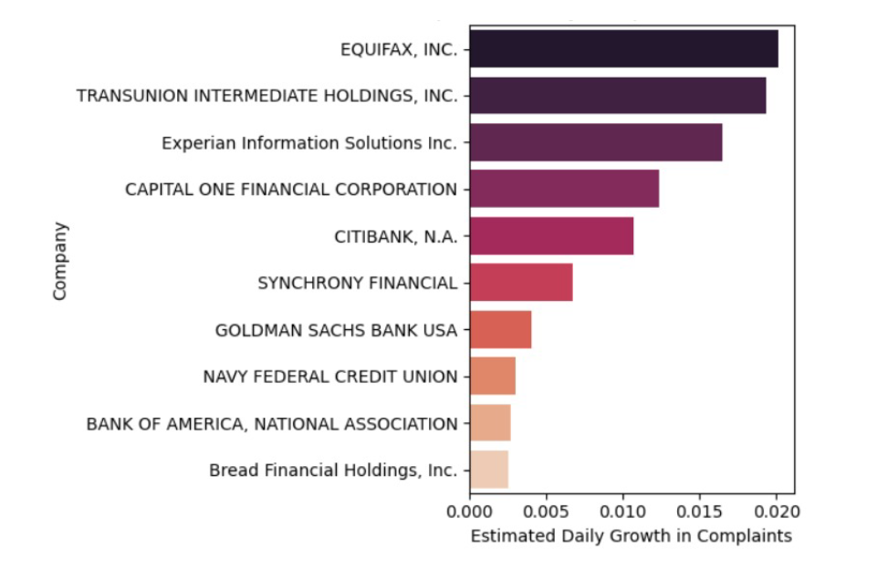
Task2
Investigate which banks show the steepest growth in complaints volume. Can you quantify this growth using time-series analysis? Identify trend and potential reasons for these trends.
Methodology: For each company, a simple linear regression model was fit using day number(time) as Independent Variable and count (number of complaints received on that day) as Dependent Variable.
Result: The given fig. shows the estimated daily growth in complaints. Equifax,INC shows the steepest growth in complaints.

Slide 6
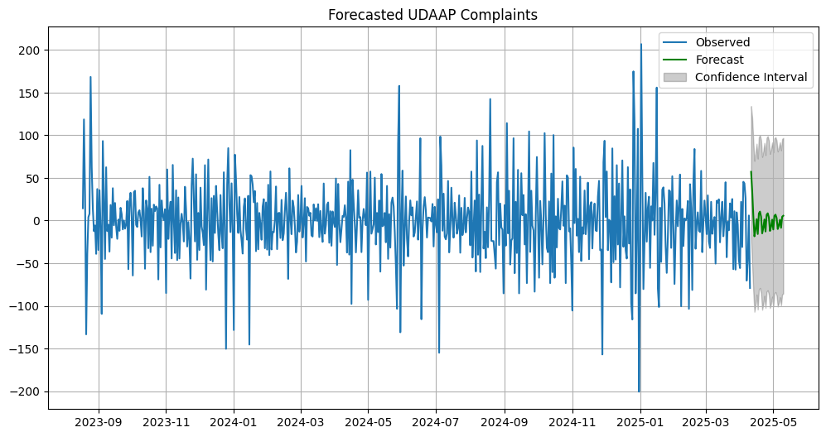
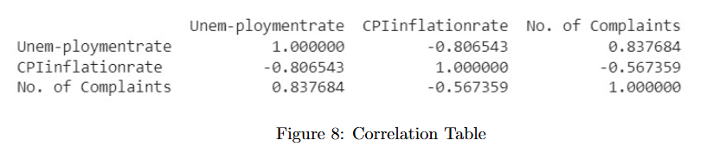
Task3
Predict future UDAAP risks using machine learning and forecasting models. Do complaints correlate with macroeconomic indicators such as inflation and unemployment rates?
Forecasting:
Using SARIMAX(0,0,2)(1,0,1,7) we forecasted UDAAP complaint volumes for the next 30 days.
The forecast graph displayed a continued upward trend, consistent with historical data patterns.
Correlation with Macroeconomic Indicators:
Result: This shows that complaints rate is significantly correlated with Macroeconomic Indicators.
Fig4: Forecasted UDAAP Complaints

Slide 7
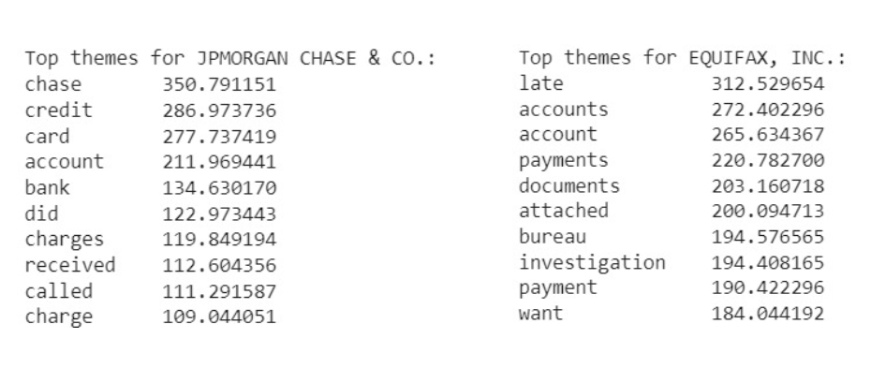
Task 4
Utilize data processing techniques to extract top themes from the complaints data. What are the most frequent UDAAP-related terms foreach bank?
Methodology
All Complaints narrative converted to lowercase, cleaned complaints were vectorized using the TF-IDF Vectorizer.
To group similar complaint narratives, K-Means clustering was applied on the TF-IDF vectors.
Result:
The most significant terms were identified based on cumulative TF-IDF scores across all complaints for that bank. Here we have share the analysis on top 2 companies.

Slide 8
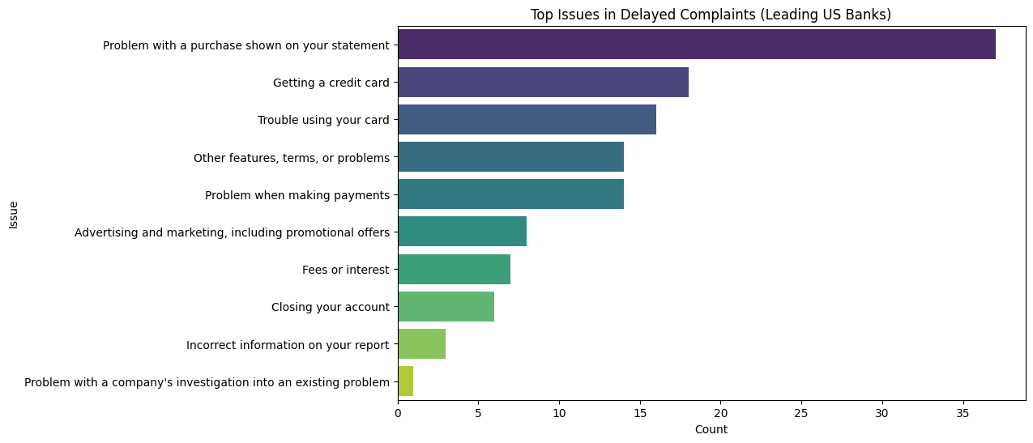
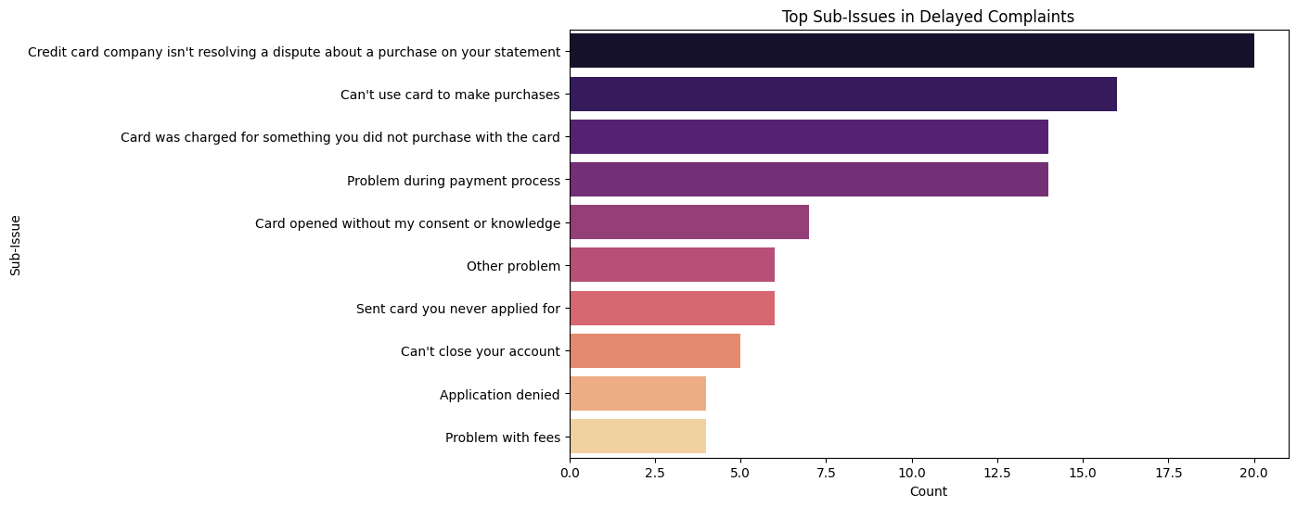
Task5
Compare the complaints with delay in resolution with leading US banks(JP Morgan Chase, Discover, American Express, Capital One, etc.)and is there any underlying themes in these complaints?
Result:
As the dataset related to the response time of the above companies are not available , so we have decided to study the response time of top US banks. The analysis included identifying the most common complaint issues and sub-issues among delayed complaints using frequency counts.

Slide 9
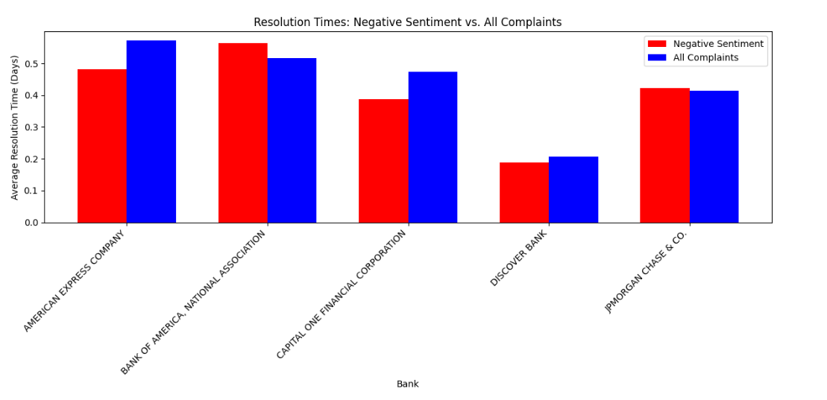
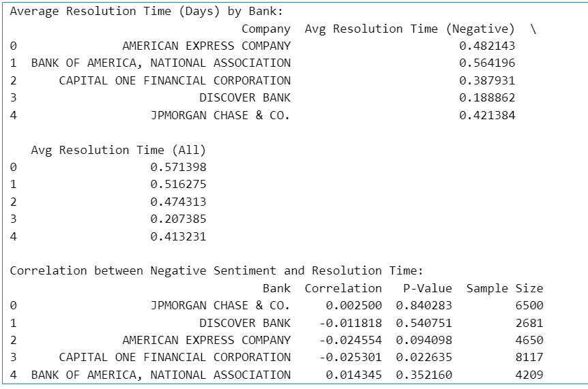
Task6
Evaluate the relationship between negative sentiment complaints and the duration of resolution times for specific banks. Does negative sentiment correlate with longer resolution times?
Methodology:
1.Computed resolution time as the difference between ”Date received” and ”Date sent to company”.
2.Applied a lexicon-based classifier (VADER Sentiment Analyzer) to classify complaint narratives as Positive, Neutral, or Negative based on compound sentiment scores.
Result: From the outputs, it is clear that banks having more negative complaints are taking more resolution time.
Fig. Negative Sentiment vs all complaints
Fig. Outputs

Slide 10
Thank You

